Slide 1
Telephony project
PRESENTATION
Presented by:
Ali Abdallah – 6352
Hassan Mohsen – 6295
Alaa Fadlallah – 6445
Mohammad Kansoun - 6123

Slide 2
Agenda
1. Introduction
2. Problem Statement
3. System and Architecture
4.The tool behind the project
5. limitations
6. Future work

Slide 3

1.With growing security concerns, the demand for intelligent, responsive systems is more critical than ever. 2. Our solution combines real-time face recognition with instant messaging to secure entry points. 3. By leveraging a Raspberry Pi for image capture and a laptop for processing, it enables immediate alerts and ensures only authorized access.
1. Introduction:

Slide 4
2. Problem statement
Legacy systems are unable to identify individuals in real time
Relying on manual surveillance is time-consuming and unreliable
Unauthorized entries often go undetected without immediate alerts
There's a growing demand for intelligent, affordable security solutions

Slide 5

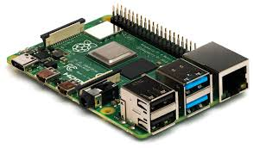
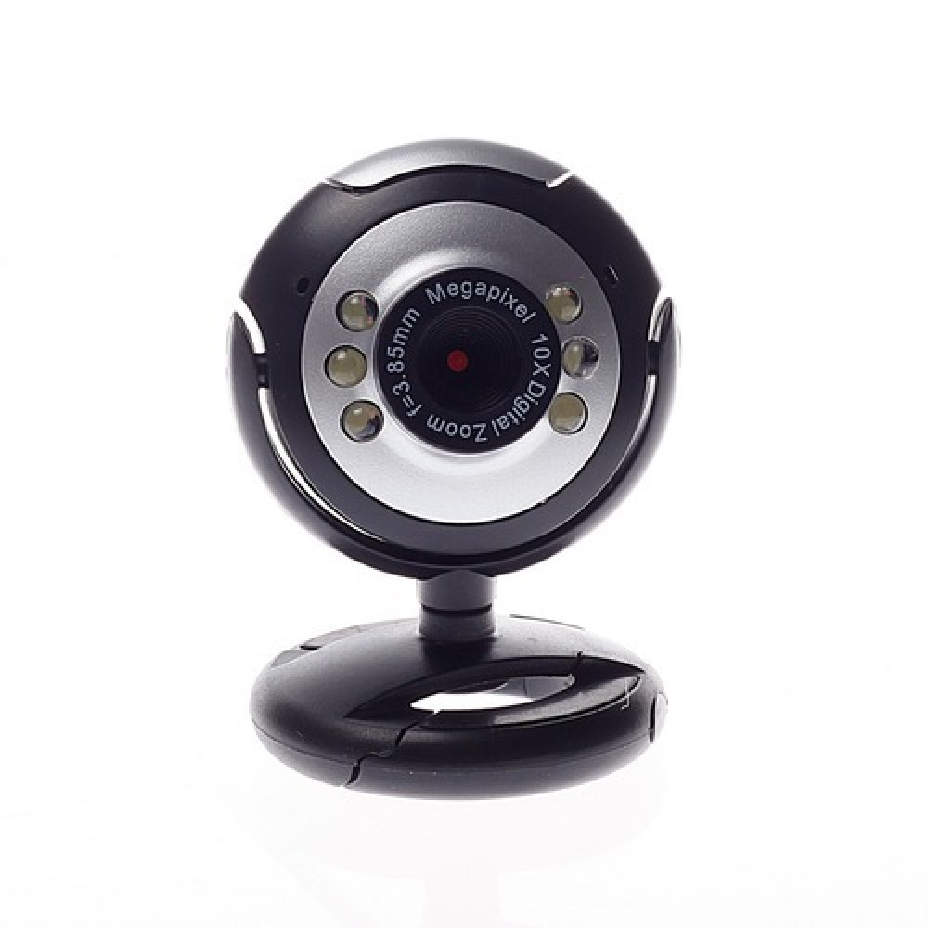


3. System Architecture

Slide 6
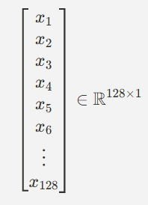

4. Face recognition

Slide 7
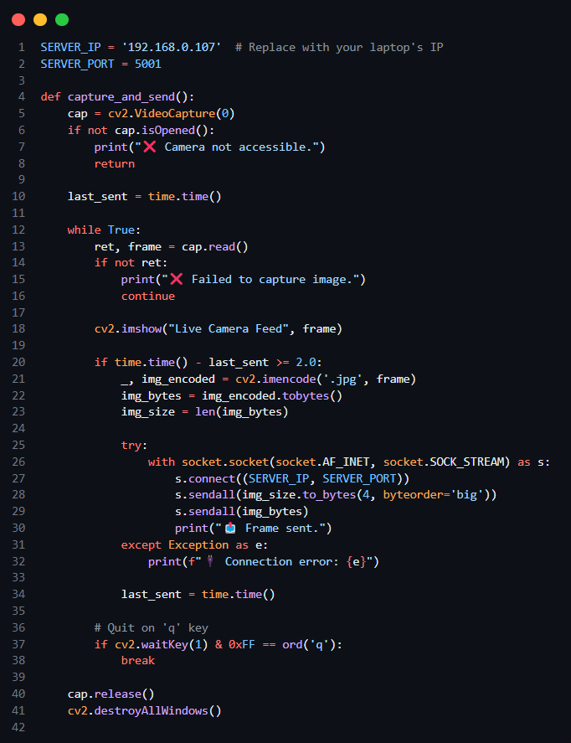
Code snippets
Client code (pi)
Steps:
Initialize the Camera Set up a cv2.VideoCapture object to access the camera stream.
Capture Video Frames Continuously Read frames from the camera in a loop to keep the video stream active.
Send a Frame to the Server Every 2 Seconds Use a timer or delay mechanism to transmit one frame every 2 seconds to the server.

Slide 8
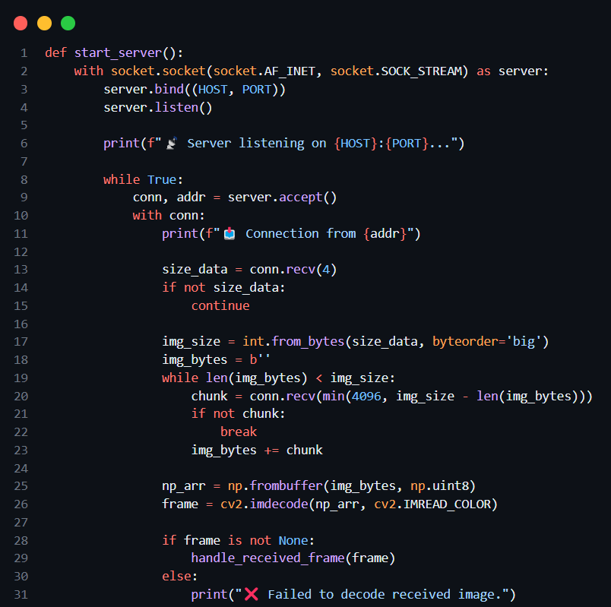
Code snippets
Server code
Steps:
Receive image from raspberry pi
Extract the size of the image
Transfer the image into a cv2 frame
Pass the frame to: `handle_received_frame`

Slide 9
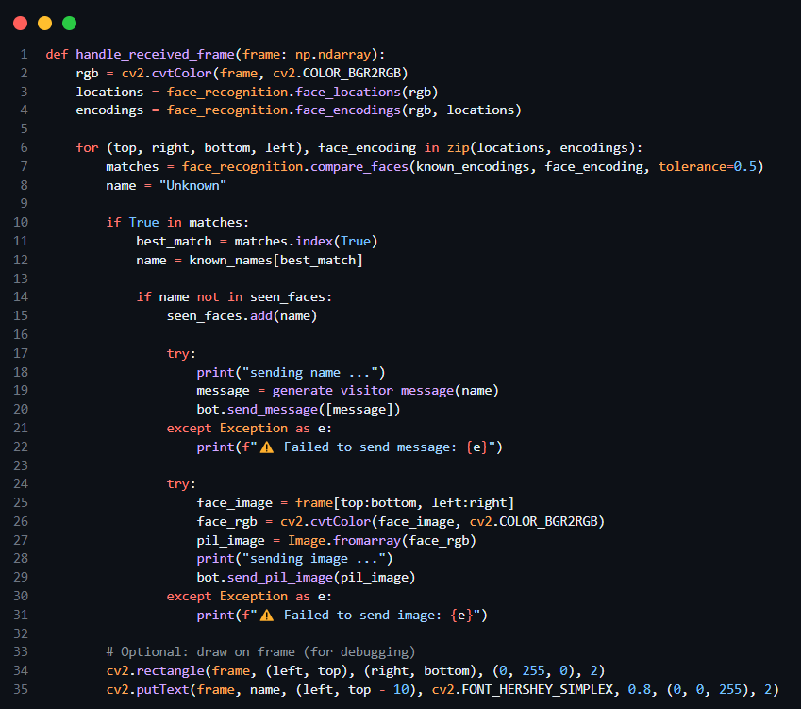
Code snippets
Handling frame
Steps:
Identify the Person from Face Embeddings Compare the incoming face encoding against the known encodings to retrieve the corresponding name.
Prevent Duplicate Alerts Add the identified name to a `seen_faces set to avoid repeated notifications. Optionally, implement a timer-based cooldown before allowing re-alerts.
Send Notification via Telegram Bot Use the Telegram bot to send the person's name along with the captured face image to the designated chat.

Slide 10
5. Limitations
1. Limited Camera Performance USB webcams may have low resolution or frame rate, affecting face detection accuracy, especially in poor lighting conditions.
2. Face Recognition Accuracy The `face_recognition` library may struggle multiple things.
3. Basic spoofing if no liveness detection
3. Lack of Real-Time Efficiency Sending one frame every 2 seconds may miss fast-moving subjects or brief appearances.

Slide 11
6. Future work
1. Develop an Administrative Dashboard for Face Database Management Create a secure and user-friendly web-based dashboard that allows administrators to add, update, and remove entries from the face database.
2. Enable Multiple Face Tracking Track and label multiple faces simultaneously, sending alerts for each one independently.
3. Improve Face Recognition Model Replace `face_recognition` with more advanced deep learning models (e.g. FaceNet, ArcFace) for higher accuracy and robustness.

